Slide 1
Why I use R and Github
A COVID-19 special presentation
Kristen Peck
11 May 2020

Slide 2
Disclaimers
I know only just enough to be dangerous about this topic: https://github.com/bcgov/bcgov-r-geo-workshop
R and Github are located in the nerdverse
This is not a how-to guide

Slide 3
What is R?
Basic scripting language (based on S)
Open-source and ever-expanding
https://cran.r-project.org/
Greatly helped along by Rstudio
https://rstudio.com/

Slide 4
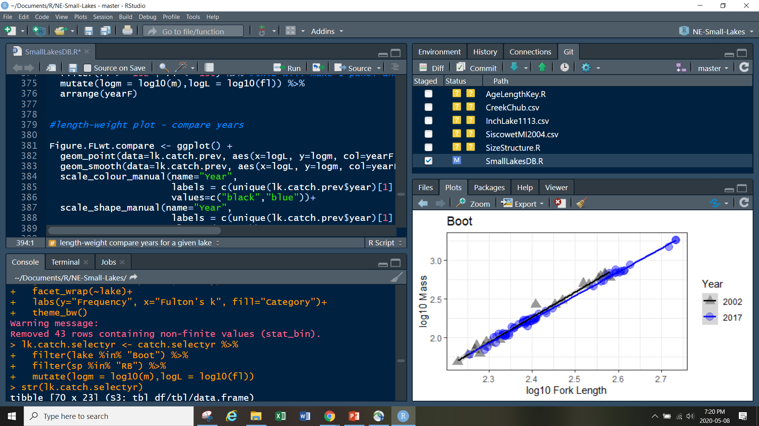

Slide 5
What is Github?
Git is a version-control program (forget the “save” button)
https://git-scm.com/
Github is an online platform for sharing and collaborating on scripts
https://github.com/
Approved for use by the Province of BC
https://github.com/bcgov/BC-Policy-Framework-For-GitHub

Slide 6
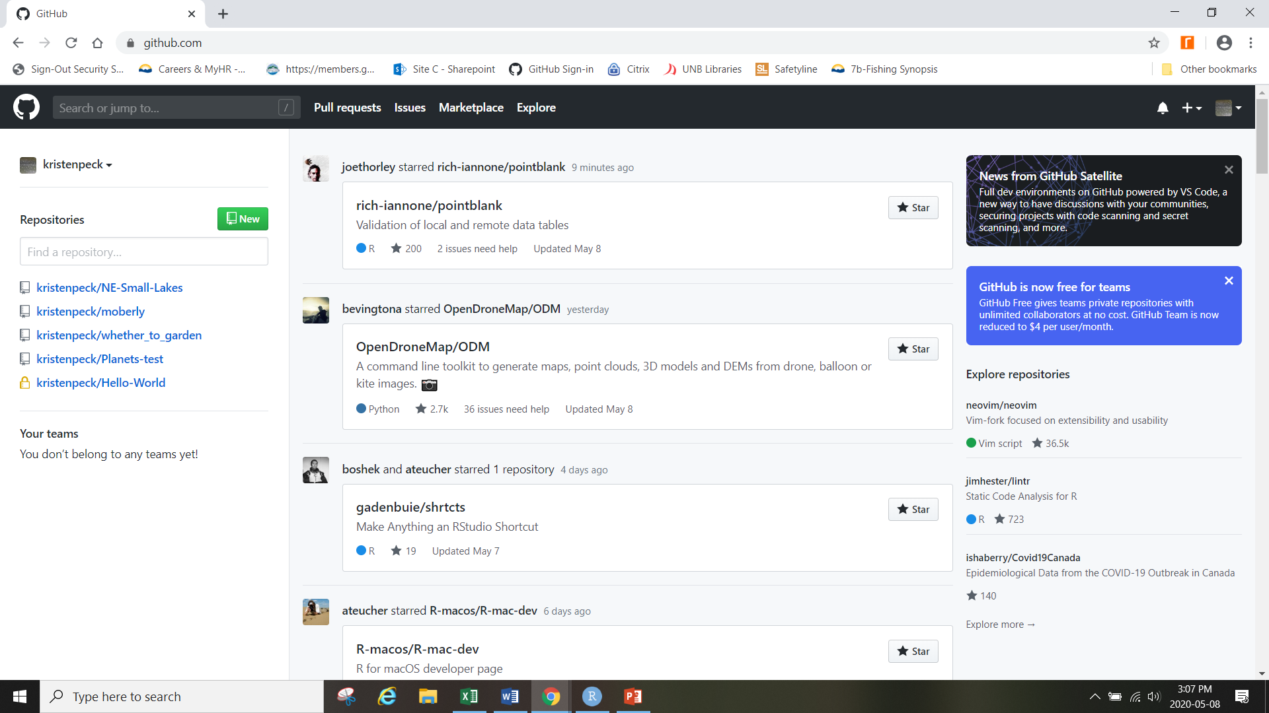

Slide 7
And how are they related?
R scripts and R projects are hosted on Github, where you “commit”, “push” and “pull” to and from.
You can also post results to the page, copy (pull) someone else’s script and suggest (push) changes to it (I am still too afraid to do this)
RStudio lets you do it all from there

Slide 8
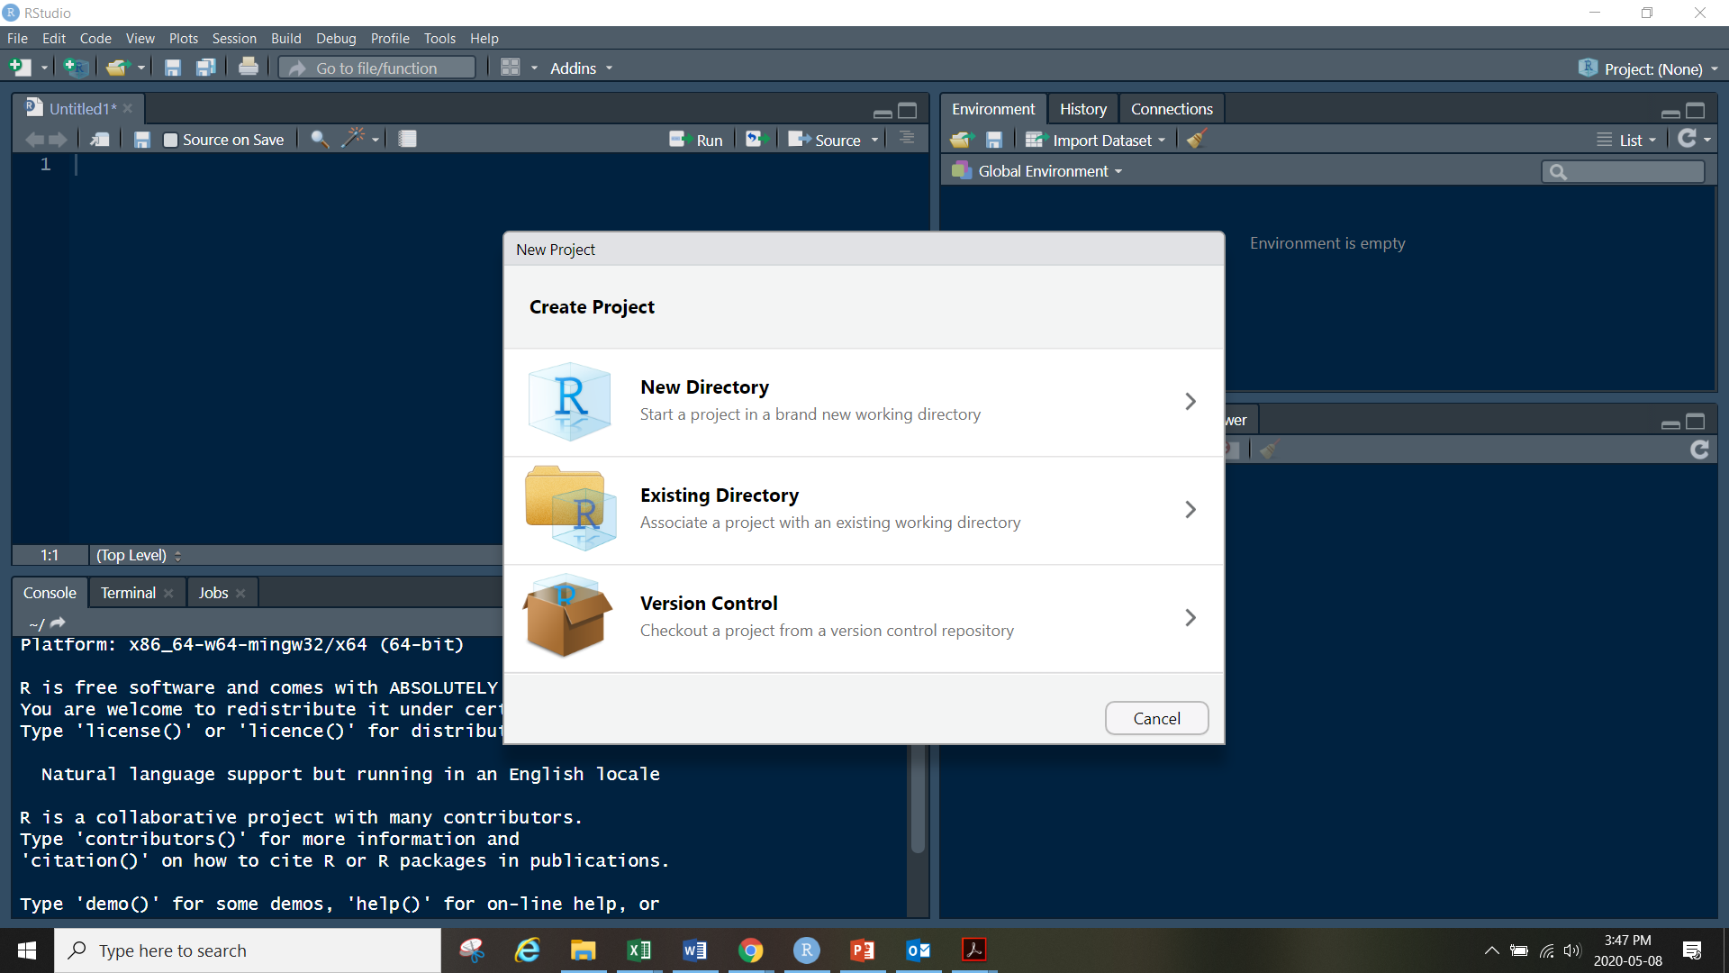

Slide 9
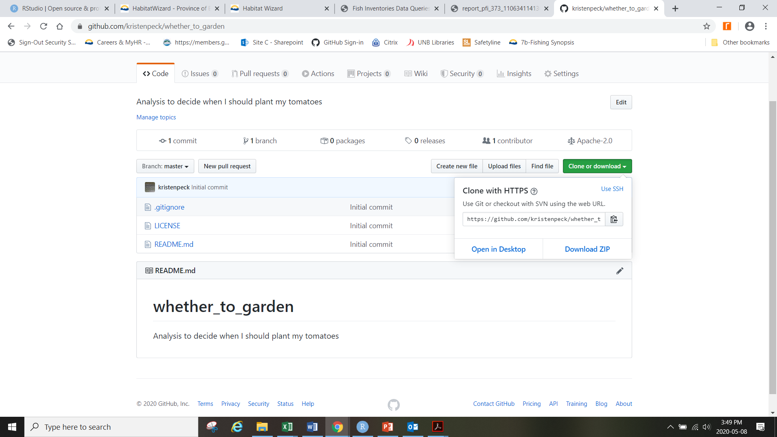

Slide 10
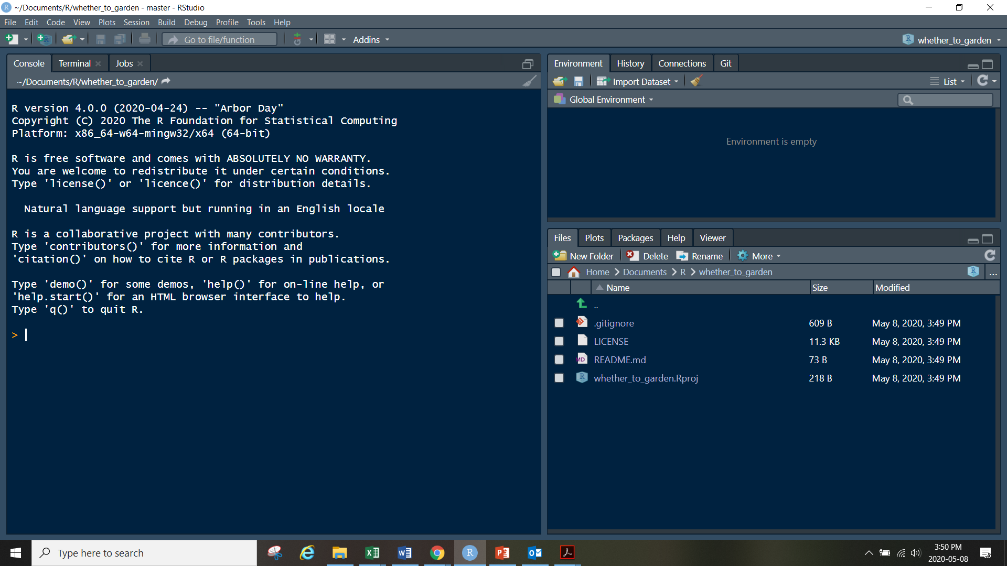
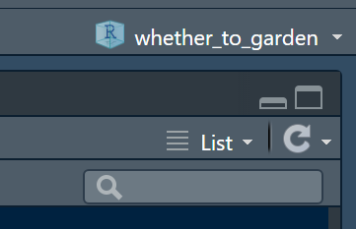

Slide 11
And how are they related?
You can pull down, push up and commit changes to github directly in RStudio

Slide 12
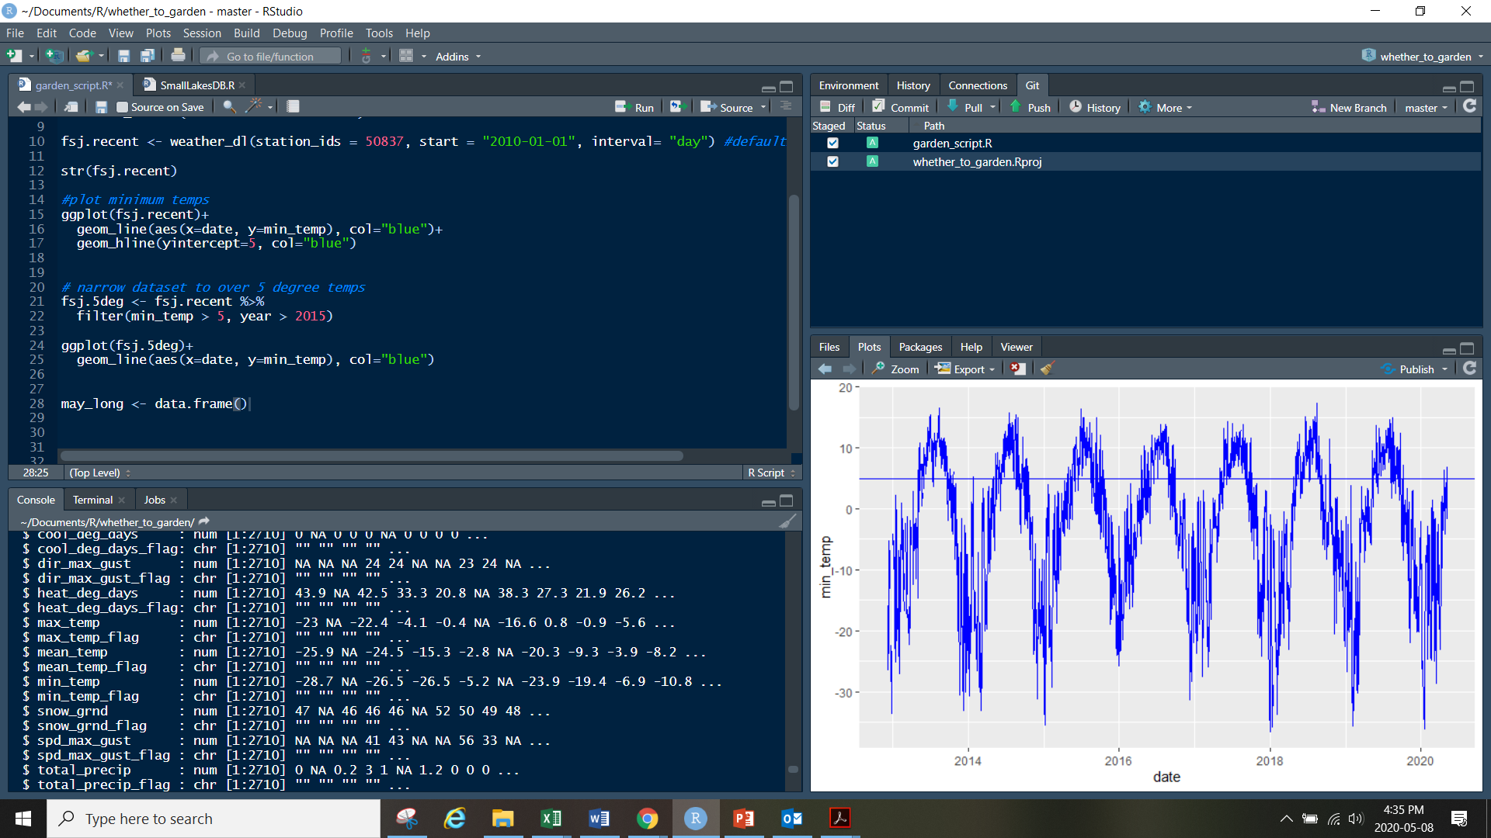

Slide 13
To the script!
Example of trying to figure out a real-world problem with R and Github…

Slide 14
But seriously, why do this?
You can work off your C drive and straight to/from Github. No stops at VPN, no collecting gray hairs waiting for your computer to respond
Anyone can now pull down and work on my kristenpeck/whether_to_garden project
It’s very easy to collaborate on projects and make sure everyone is working on the correct version
You don’t lose your work, even if it is deleted off of your computer

